Slide 1
CHI-SQUARE STATISTIC
Course Bio Statististics

Slide 4
Chi-Square Statistic
The test statistic to be used in test of independence is as following:

Slide 5
Steps Involved

Slide 6
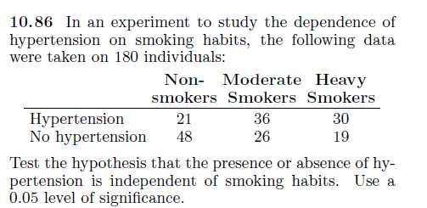
Question

Slide 7
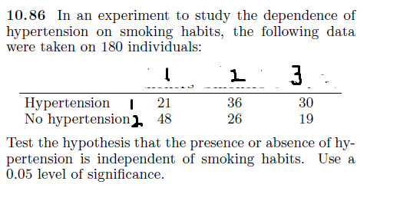
How to Solve on SPSS
Take these as codes to enter in SPSS

Slide 8
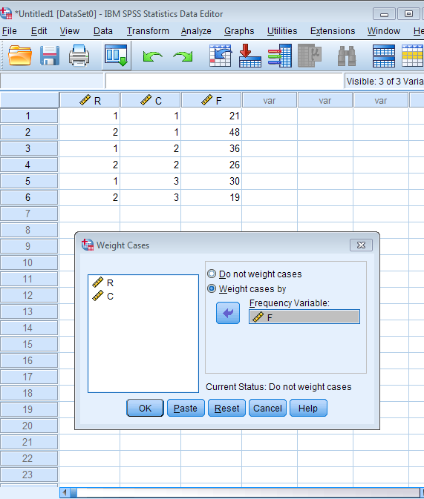
How to Solve on SPSS
After entering the data and turning on the weight cases. Click Analyze -> Descripitive Statistics-> Cross tabs

Slide 9
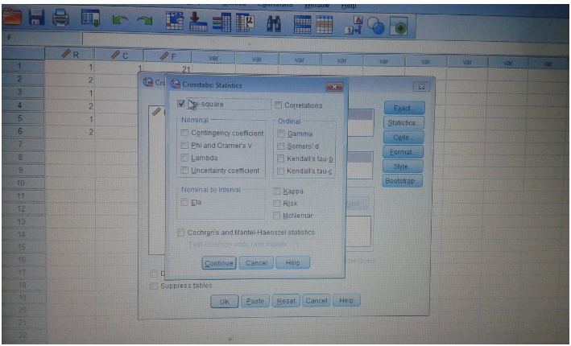
Now send R variable in Row(s) section and C variable in Column section
->Statistics
Click ->chi-square option

Slide 10
Result

Slide 11
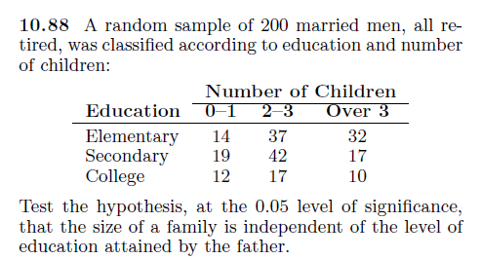
Question for practice

Slide 12
Question for practice

Slide 13
The End

